Slide 1

SQL-Powered Analytics
Ola Ride Data
Analysis Report
Operational Intelligence for Ride-Hailing Optimization
20K
62%
+30%
July 2024
Bookings Analyzed
Completion Rate
WoW Growth
Analysis Period

Slide 2
PRESENTATION OVERVIEW
Executive Overview
A comprehensive data-driven journey through Ola's operational performance
01
Business Problem
05
Route Performance
Peak demand imbalances, cancellation rates, and route failures
High-risk routes with >20% failure rates
02
Data Foundation
06
Growth Trends
20K booking records structure and quality metrics
Week-over-week trajectory and demand concentration
03
Peak Demand Patterns
07
SQL Methodology
Hourly trends, time slots, and weekday patterns
Window functions, aggregations, and technical approach
04
Cancellation Analysis
08
Recommendations
Attribution, root causes, and hourly patterns
Strategic actions for operational excellence

Slide 3
CHALLENGE OVERVIEW
Business Problem Statement
Peak Demand Imbalances
High Cancellation Rates
Route-Specific Failures
Service gaps during high-demand periods lead to customer dissatisfaction and lost revenue opportunities.
Both customer and driver cancellations erode revenue and create operational inefficiencies across the network.
Certain pickup-drop combinations experience disproportionately high failure rates, indicating systemic issues.
Critical
28%
>20%
Impact on Revenue
Total Cancellation Rate
Routes with High Failure
Business Impact
These challenges directly impact customer satisfaction, revenue generation, and operational efficiency. Without data-driven intervention, these issues compound over time, creating a negative feedback loop that threatens market competitiveness.

Slide 4
PROJECT SCOPE
Project Objectives & Deliverables
Data Preparation
Advanced SQL Analysis
Excel-Based Cleaning
Window Functions & Aggregations
Data Sanitization: Remove duplicates, handle null values, standardize formats
WoW Growth: LAG() window functions for week-over-week tracking
Time-Slot Performance: CASE statements for categorization
Pivot Analysis: Quick exploratory analysis of key dimensions
Route Analysis: HAVING clause for high-failure route identification
Quality Metrics: Validate data integrity before SQL analysis
Power BI Dashboard
GitHub Repository
Operational Intelligence
Technical Reproducibility
KPI Cards: Executive metrics with trend indicators
SQL Scripts: All analysis queries with documentation
Heatmaps: Demand patterns across time and geography
Data Files: Sample datasets for replication
Trend Lines: Week-over-week growth visualization
README: Setup instructions and methodology

Slide 5
DATA OVERVIEW
Data Foundation: 20K Booking Records
Dataset Schema
Data Coverage
Booking_ID
Unique identifier
Date
Booking date
Analysis Period
July 2024
Time
Booking timestamp
Booking_Status
Success/Canceled
Customer_ID
Customer reference
Vehicle_Type
Auto, Prime, etc.
Total Records
20,000
Pickup_Location
Origin point
Drop_Location
Destination point
V_TAT
Vehicle turnaround
C_TAT
Customer turnaround
Data Quality
99.2%
Canceled_Rides
By customer/driver
Incomplete_Rides
Failure tracking
Booking_Value
Revenue per ride
Payment_Method
Cash/Card/UPI
Ride_Distance
KM traveled
Ratings
Driver & Customer
Booking Status Distribution
Success
62%
Customer Cancel
10%
Driver Cancel
18%
Driver Not Found
10%

Slide 6
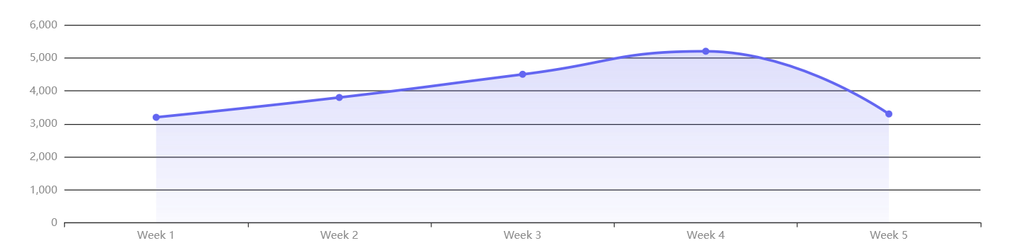
EXECUTIVE DASHBOARD
Key Performance Metrics at a Glance
Total
Success
Cancel
Cancel
Growth
20K
62%
10%
18%
+30%
Total Bookings
Completion Rate
Customer Cancel
Driver Cancel
WoW Growth
Weekly Booking Trend

Slide 7
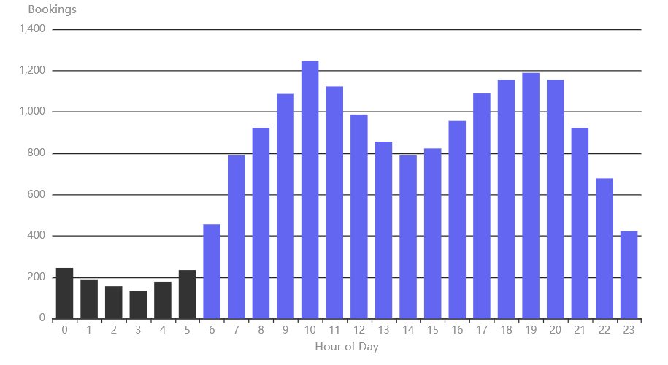
DEMAND PATTERNS
Peak Demand Analysis: Hourly Patterns
24-Hour Booking Distribution
Top 3 Peak Hours
1
10:00 AM
1,247
Highest demand window
2
7:00 PM
1,189
Evening rush peak
3
8:00 PM
1,156
Post-dinner demand
Key Insights
Bimodal Pattern: Clear peaks at 10 AM and 7-8 PM indicate commute and leisure patterns
Low Demand: 2-5 AM shows minimal activity (<100 bookings/hour)
Steady Growth: Demand builds from 6 AM, peaks mid-morning, stabilizes afternoon

Slide 8
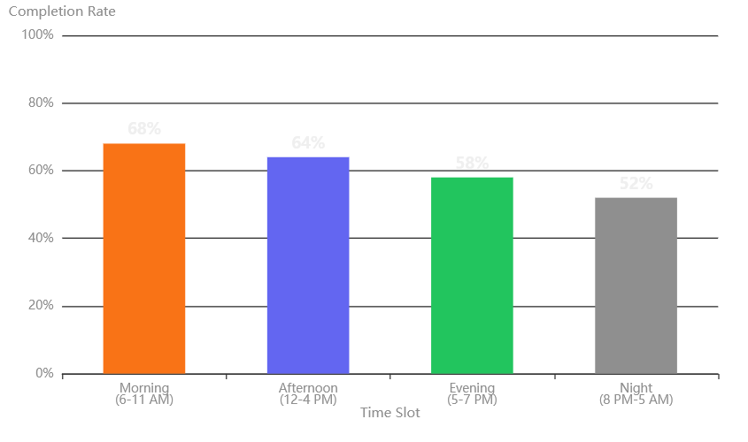
OPERATIONAL WINDOWS
Time Slot Performance: Morning to Night
Completion Rate by Time Slot
Time Slot Definitions
Morning
6 AM - 11 AM
Afternoon
12 PM - 4 PM
Evening
5 PM - 7 PM
Night
8 PM - 5 AM
SQL Implementation
SELECT
CASE
WHEN
hour_col
BETWEEN
6
AND
11
THEN
'Morning'
WHEN
hour_col
BETWEEN
12
AND
16
THEN
'Afternoon'
WHEN
hour_col
BETWEEN
17
AND
19
THEN
'Evening'
ELSE
'Night'
END
AS
time_slot

Slide 9
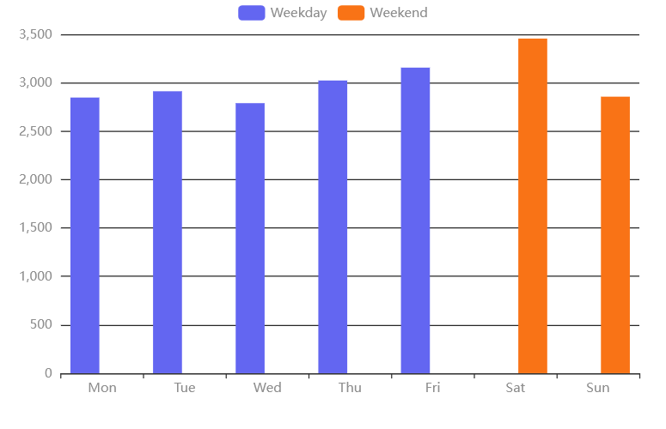
WEEKLY PATTERNS
Weekday vs Weekend Patterns
Daily Booking Volume Comparison
Performance Summary
Weekdays
2,847
Avg bookings per day
64% completion
Weekends
3,156
Avg bookings per day
58% completion
Strategic Insights
Higher Weekend Demand: 10.8% more bookings on weekends
Lower Weekend Success: 6 percentage points lower completion rate
Opportunity: Weekend surge pricing + driver incentives

Slide 10
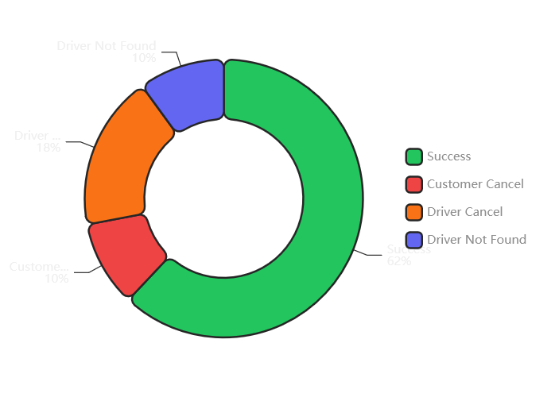
CANCELLATION ANALYSIS
Cancellation Deep Dive: Attribution Analysis
Cancellation Attribution Breakdown
Cancellation Metrics
Success
12,400
Completed rides
62%
Customer Cancel
2,000
User-initiated
10%
Driver Cancel
3,600
Driver-initiated
18%
Driver Not Found
2,000
No driver available
10%
Key Finding
Driver-side issues (cancel + not found) account for 28% of all bookings

Slide 11
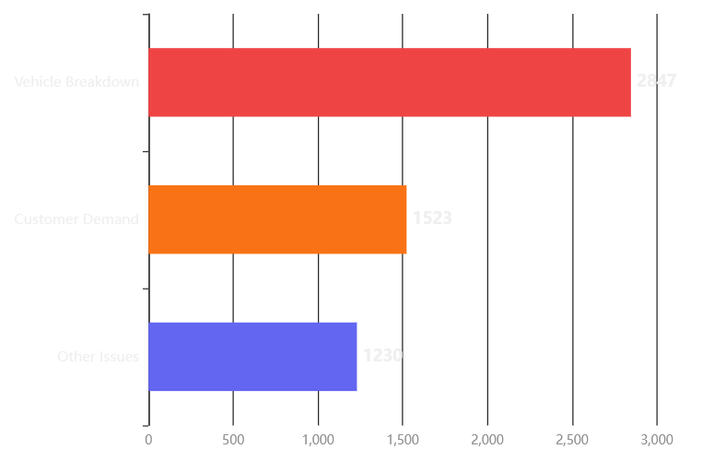
ROOT CAUSE ANALYSIS
Cancellation Reasons: Root Cause Analysis
Top Cancellation Reasons Distribution
Reason Breakdown
Vehicle Breakdown
2,847
51% of cancellations
Customer Demand
1,523
27% of cancellations
Other Issues
1,230
22% of cancellations
Actionable Insight
Vehicle breakdown (51%) is preventable with better maintenance protocols

Slide 12
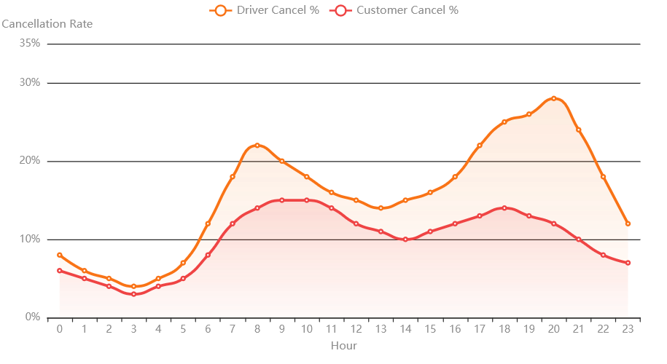
TEMPORAL ANALYSIS
Hourly Cancellation Patterns
Cancellation Rates by Hour (24-Hour View)
Peak Cancellation Hours
Driver Cancel Peak
8 PM
28% cancellation rate
Customer Cancel Peak
10 AM
15% cancellation rate
Lowest Cancel Rate
3 AM
4% cancellation rate
Correlation Insights
Inverse Pattern: High demand hours (10 AM, 7-8 PM) show elevated cancellation rates
Driver Stress: Evening peaks correlate with higher driver cancellations
Customer Patience: Morning rush shows higher customer-initiated cancellations

Slide 13
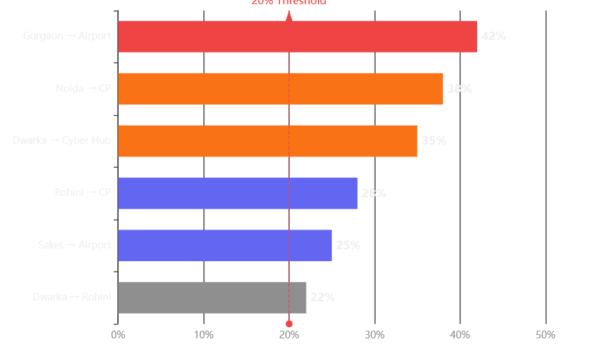
GEOGRAPHIC ANALYSIS
High-Risk Routes: >20% Failure Rate
Top Problem Routes by Cancellation Rate
SQL Filter Criteria
SELECT route, cancellation_rate
FROM bookings
GROUP BY route
HAVING cancellation_rate > 0.20
AND total_bookings >= 50
Problem Route Analysis
Worst Route
42%
Gurgaon → Airport
156 bookings analyzed
Second Worst
38%
Noida → Connaught Place
203 bookings analyzed
Third Worst
35%
Dwarka → Cyber Hub
178 bookings analyzed

Slide 14
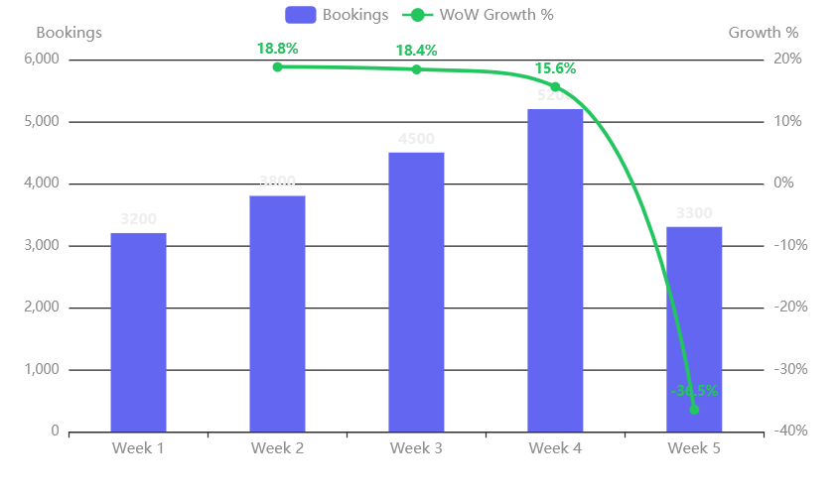
GROWTH TRAJECTORY
Week-over-Week Growth Trajectory
Booking Volume & Growth Rate by Week
SQL Window Function
WITH weekly_bookings AS (
SELECT week_col, COUNT(*) as bookings
FROM bookings
GROUP BY week_col
)
SELECT week_col,
bookings,
LAG(bookings) OVER (ORDER BY week_col) as prev_week,
(bookings - LAG(bookings) OVER (ORDER BY week_col))
/ LAG(bookings) OVER (ORDER BY week_col) * 100
AS wow_growth_pct
FROM weekly_bookings
Growth Analysis
Strong Momentum: Consistent growth from Week 1 to Week 4 (62.5% total growth)
Peak Growth: Week 3→4 shows highest acceleration (15.6% WoW)
Week 5 Drop: Partial week data shows decline (likely incomplete)

Slide 15
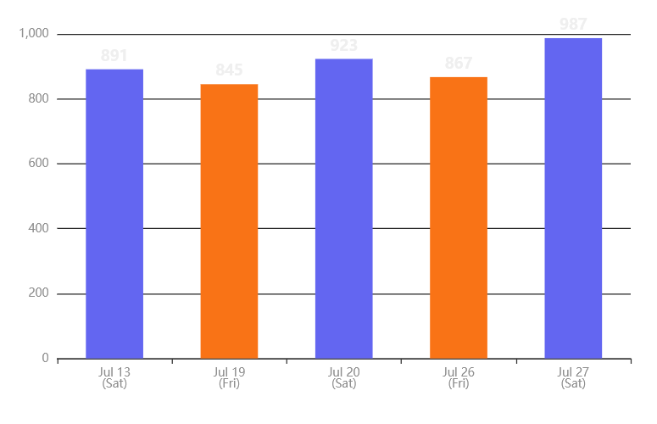
DEMAND CONCENTRATION
Busiest Days & Demand Concentration
Top 5 Busiest Days in July 2024
Top 5 Busiest Days
1
July 27
987
Saturday - Weekend peak
2
July 20
923
Saturday - Weekend peak
3
July 13
891
Saturday - Weekend peak
4
July 26
867
Friday - Pre-weekend surge
5
July 19
845
Friday - Pre-weekend surge
Pattern Identified
All top 5 days are weekends (Sat) or pre-weekend (Fri)

Slide 16
TECHNICAL APPROACH
SQL Analysis Methodology
Window Functions
Multi-Level Aggregations
-- Week-over-Week Growth
-- Time Slot Analysis
LAG(bookings)
CASE
OVER (ORDER BY week_col)
WHEN hour_col BETWEEN 6 AND 11
AS prev_week_bookings
THEN 'Morning'
-- Calculates previous week's value for comparison
WHEN hour_col BETWEEN 12 AND 16
THEN 'Afternoon'
LAG(): Access previous row values for sequential analysis
END AS time_slot
OVER(): Define window frame for calculations
PARTITION BY: Group data for independent calculations
CASE: Conditional categorization of data
GROUP BY: Multi-dimensional aggregation
HAVING: Filter aggregated results
Advanced Filtering
Query Optimization
-- High-Risk Routes
-- Efficient Date Extraction
HAVING
SELECT
cancellation_rate > 0.20
hour(Time_col) as hour_col,
AND total_bookings >= 50
dayname(Date_col) as day_name,
-- Ensures statistical significance
week(Date_col) as week_col
FROM bookings
HAVING: Post-aggregation filtering
Threshold Logic: Statistical significance checks
Built-in Functions: hour(), dayname(), week()
UNION: Combine multiple result sets
CTEs: Common Table Expressions for readability
Indexing: Optimized for 20K records

Slide 17
ACTIONABLE INSIGHTS
Strategic Recommendations
Peak Hour Optimization
High-Risk Route Intervention
Driver Allocation Strategy
Targeted Problem Resolution
10 AM Focus: Increase driver availability by 25% during peak morning hours
Gurgaon → Airport: 42% failure rate - deploy dedicated airport fleet
7-8 PM Surge: Deploy additional drivers for evening rush (1,189 bookings/hour)
Noida → CP: 38% failure rate - implement route-specific incentives
Dynamic Pricing: Implement surge pricing during peak windows to balance demand
Geofencing: Create high-priority zones with guaranteed driver availability
Expected Impact
Expected Impact
+8% Completion Rate
-15% Route Failures
Cancellation Prevention
Weekend Growth Strategy
Driver-Side Issue Mitigation
Capitalize on Demand Surge
Vehicle Maintenance: 51% of cancellations due to breakdown - preventive maintenance program
Weekend Premium: 10.8% higher demand justifies premium pricing
Friday-Saturday Focus: Top 5 busiest days are Fri/Sat - maximize availability
Driver Retention: Address 18% driver cancellation rate with better incentives
WoW Momentum: Sustain 30% growth trajectory with targeted promotions
Real-Time Monitoring: Alert system for high cancellation probability routes
Expected Impact
Expected Impact
+20% Weekend Revenue
-12% Cancellation Rate

Slide 18

Analysis Complete
Driving Operational Excellence
Data-driven insights for improved service reliability, enhanced customer satisfaction, and sustainable revenue growth.
62%
+30%
4
Completion Rate
WoW Growth
Key Recommendations
Analysis powered by SQL Window Functions • 20,000 booking records • July 2024

